Slide 1
Artificial Intelligence as a driver for Innovation in Digital Health Francesco Pugliese, Central Directorate for Methodology and Design of Statistical Processes, Istat Roma | xx May 2026 | La Sapienza

Slide 2
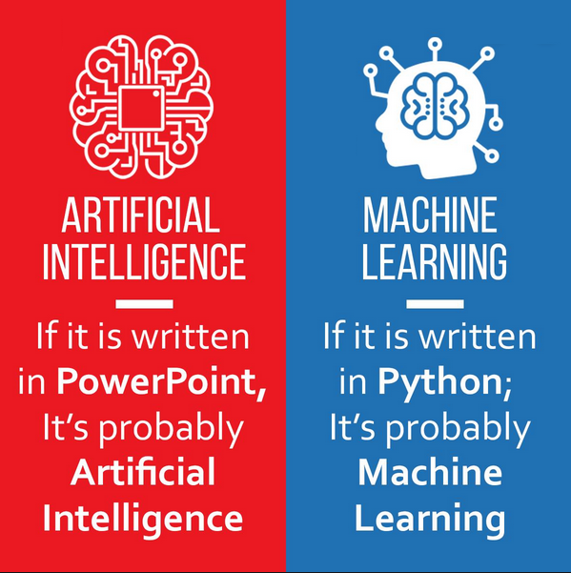
Difference between AI and ML

Slide 3
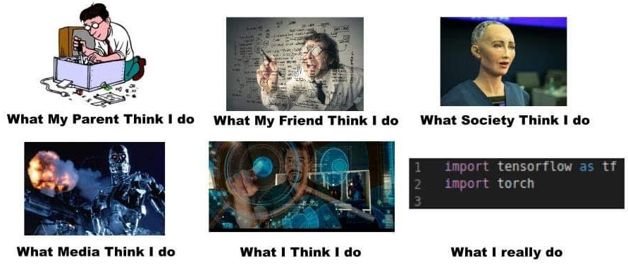
MACHINE LEARNING ENGINEER

Slide 4
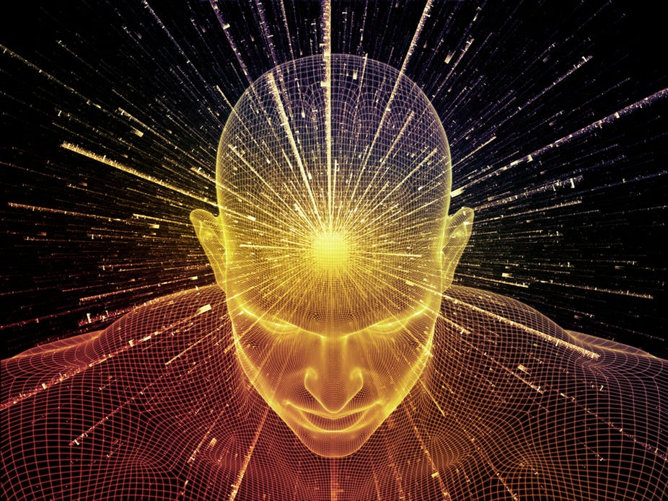
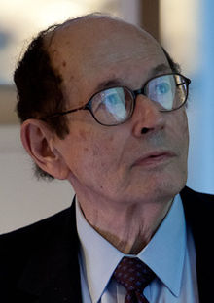
WHAT IS CONSCIOUSNESS?
DISSOCIATION BETWEEN CORTICAL ACTIVITY AND COUSCIOUSNESS
During episodes of unconsciousness, the child’s brain is by no means inactive; it is actually hyperactive.
The observation of similar firing rates between waking and slow-wave sleep represents both the most striking dissociation between cortical activity and couscioussness.
It indicates that the presence of “normal” firing levels in the cerebral cortex is not a sufficient criterion for consciousness.
Edelman, Gerald. A Universe Of Consciousness: How Matter Becomes Imagination
WHAT IS THE SUBJECTIVE EXPERIENCE?
NOBODY KNOWS

Slide 5
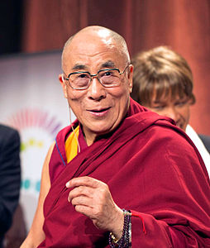
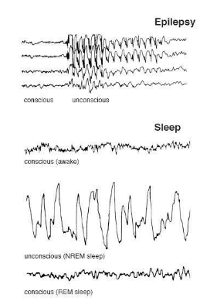
How Thoughts can change the Brain
Conscious Experience requires PATTERNS OF NEURAL ACTIVITY THAT ARE HIGHLY DIFFERENTIATED (Gerald Edelman
Tenzin Gyatso (Dalai Lama): “What if the brain comes from consciousness instead of consciousness coming from the brain?”

Slide 6
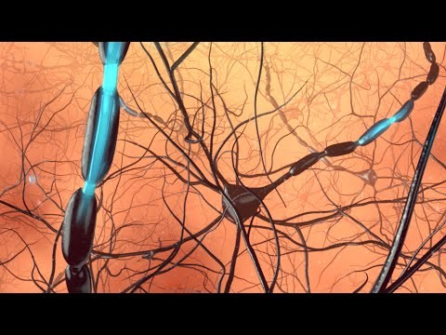
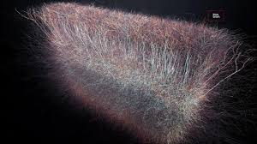
HUMAN BRAIN VS CONSCIOUSNESS
An High Dimensional and Complex Neural Network
The lack of a formal link between neural network structure and its emergent function has hampered our understanding of how the brain processes information.
Scientists find evidence of a Multidimensional Universe within the Brain
Reimann, M. W., Nolte, M., Scolamiero, M., Turner, K., Perin, R., Chindemi, G., ... & Markram, H. (2017). Cliques of neurons bound into cavities provide a missing link between structure and function. Frontiers in computational neuroscience, 11, 48.

Slide 7
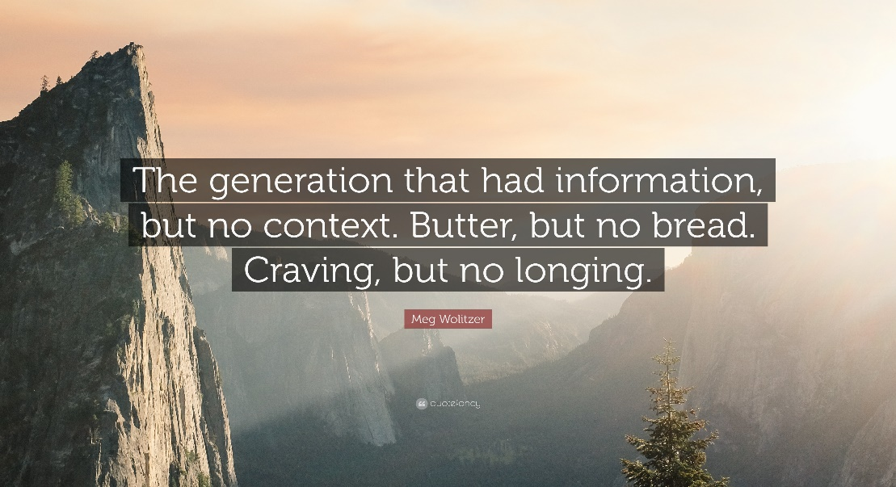
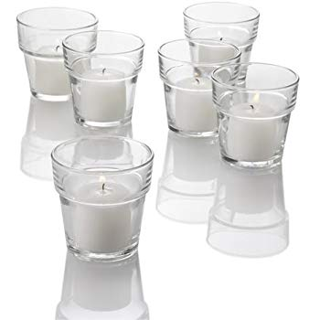
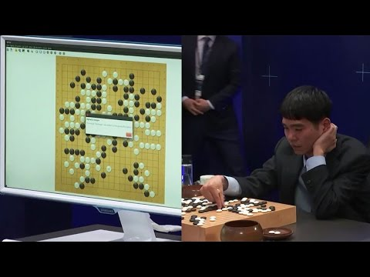
MACHINE LEARNING VS CONSCIOUSNESS
Is this a Glass or a Pot?
Where is the Human-Like Thoughts Flow?
Why and How Lea Seadol beats Alpha Go Zero
once?
Even though all metrics say it is impossible.

Slide 8
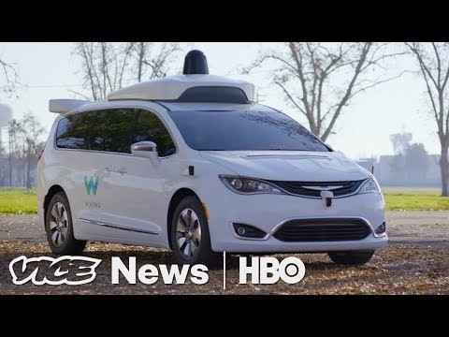
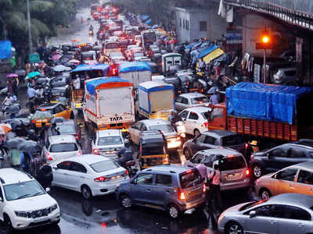
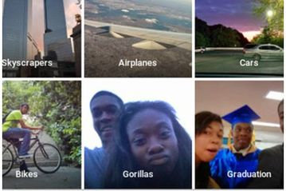
MACHINE LEARNING LIMITS
Will ever Self Driving Car cope with Mumbai Traffic?
Will ever AI have context information ?

Slide 9
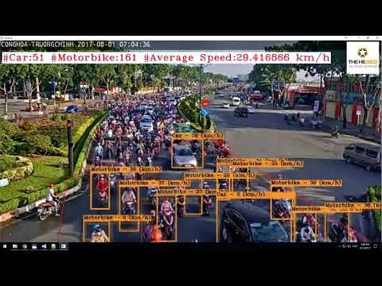
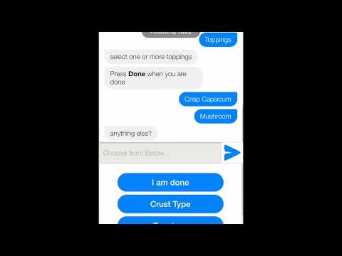
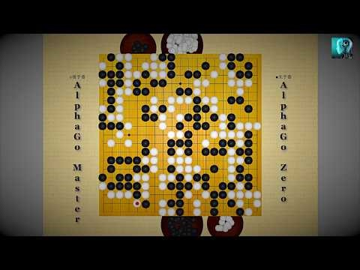
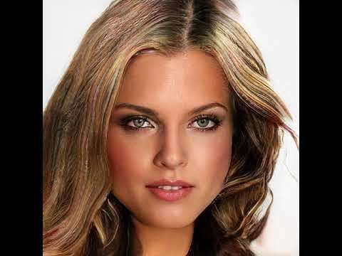
MACHINE LEARNING BREAKTHROUGHTS
Computer Vision
Natural Language Processing
A truly general Artificial Intelligence
A Generative Artificial Intelligence

Slide 10
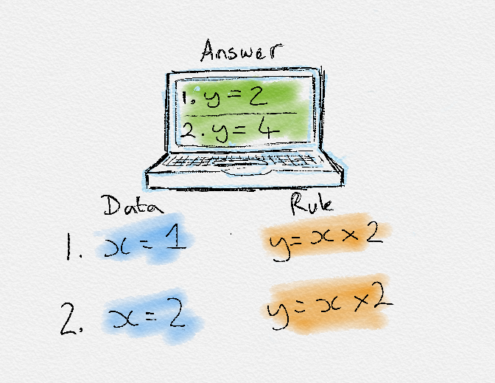
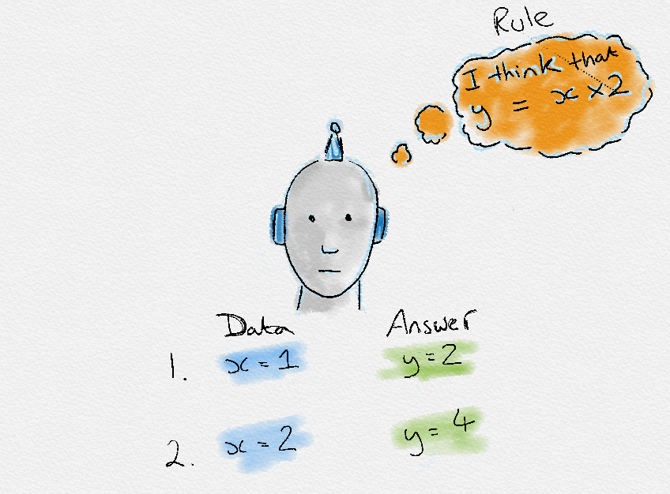
Traditional programming vs Machine Learning
Machine learning is a subfield of computer science that is concerned with building algorithms which, to be useful, rely on a collection of examples of some phenomenon.
Traditionally, software engineering combined human created rules with data to create answers to a problem. Instead, machine learning uses data and answers to discover the rules behind a problem.
To learn the rules governing a phenomenon, machines have to go through a learning process, trying different rules and learning from how well they perform. Hence, why it’s known as Machine Learning.
VS

Slide 11
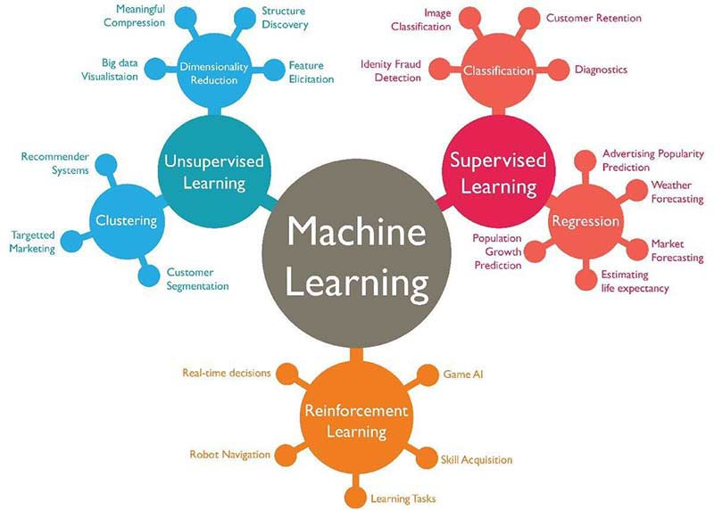
Types of Machine Learning
There are broadly 4 types of Machine Learning namely,
Supervised learning
Unsupervised learning
Semi-supervised learning
Self-supervised learning
Reinforcement learning
Each form of Machine Learning has differing approaches, but they all follow the same underlying process and theory.
The No Free Lunch theorem is famous in Machine Learning. This theorem states that there is no single algorithm that works well for all types of tasks. Each task you attempt to solve has its own idiosyncrasies, meaning its own specificities and adversities to certain Machine Learning models. Therefore, there are many algorithms and approaches that adapt to each specificity and peculiarity of an individual problem.

Slide 12
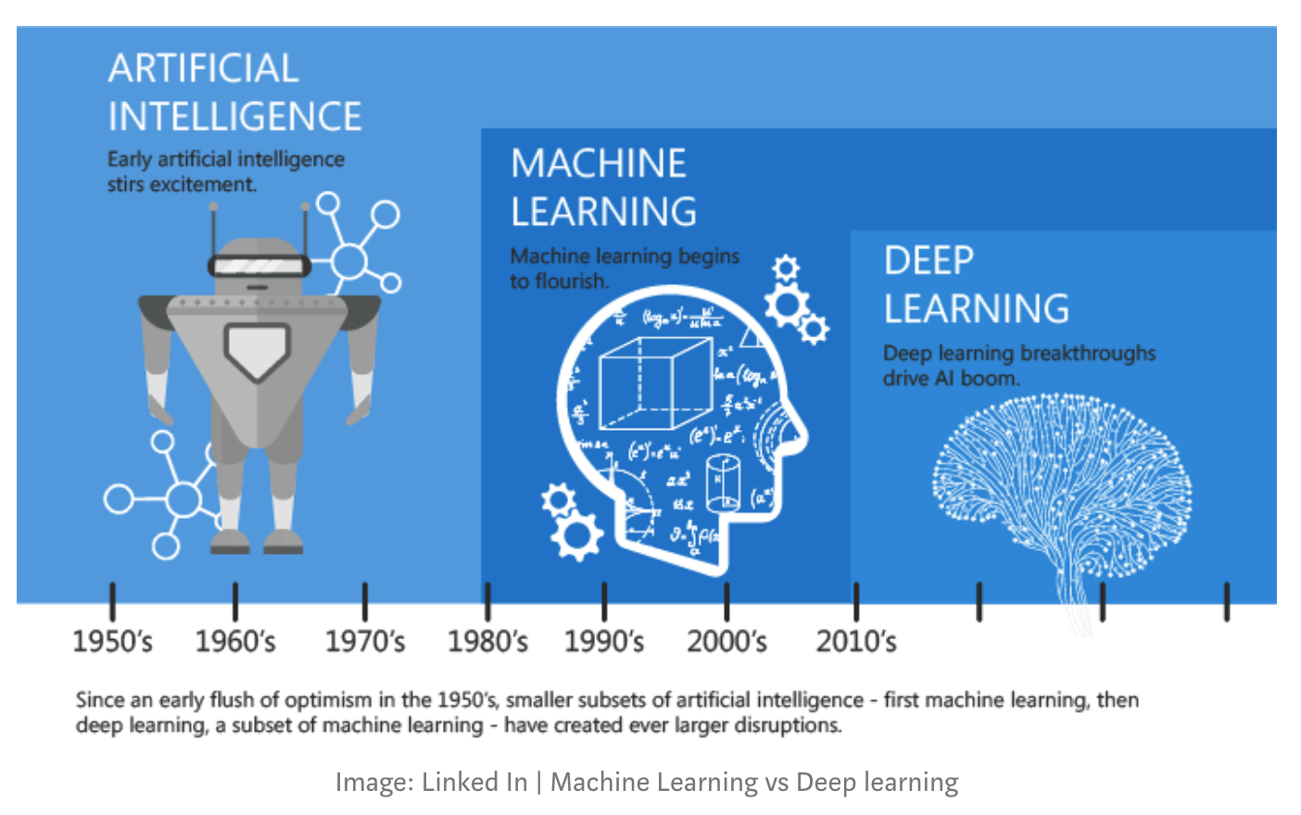
A quick history of Machine Learning

Slide 13
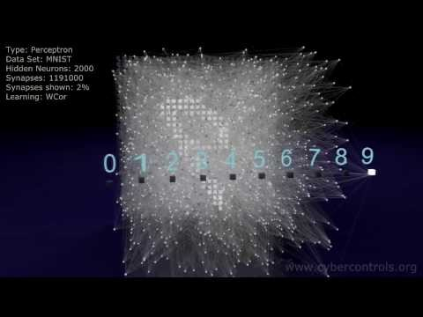
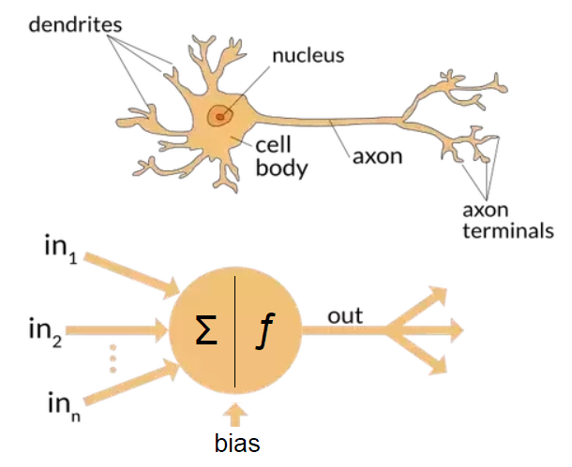
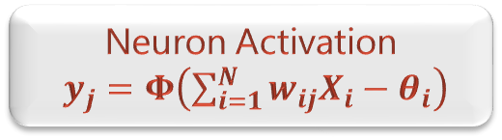
ARTIFICIAL NEURAL NETWORKS
Artificial neural networks (ANN) or Connectionist Systems are computing systems vaguely inspired by the biological neural networks that constitute animal brains (van Gerven & Bohte, 2018)
Biological Neuron Vs Artificial Neuron
Neuron Activation
i$y_{j}=Φ\left(\sum_{i=1}^{N}{w_{ij}X_{i}−θ_{i}}\right)$

Slide 14
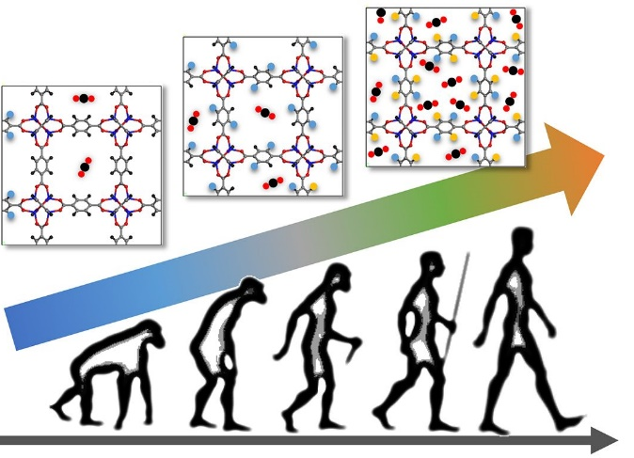
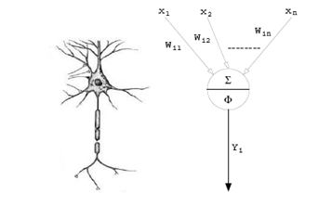
One traditional application ANN: Evolutionary robotics
In order to overcome the problems associated with the robotic system decomposition of traditional approaches (i.e. behavior-based robotics), evolutionary robotics can be used, where the robotic system is able to self-organize
[Nolfi, S., Floreano, D ., 2002].
NeuroGenetic Algorithm
Control Neural Network

Slide 15
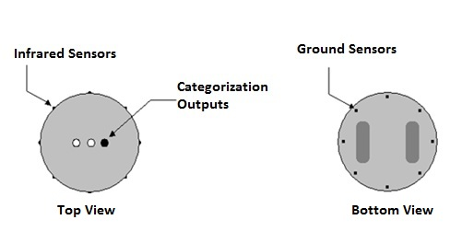
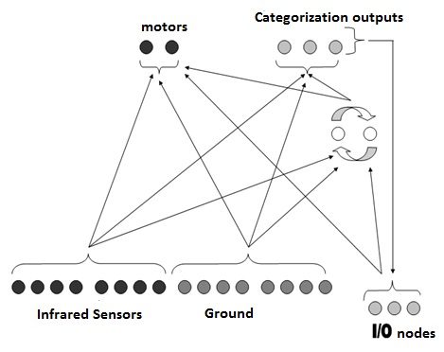

EXPERIMENTAL SETUP
ROBOT’S CHASSIS
NEURAL NETWORK
LEAKY Activation
$A_{j}=t_{j}+\sum{w_{ij}O_{i}}$ , $O_{j}=δ_{j}O^{t−1}+\left(1−δ_{j}\right)\left(1+\frac{1}{e^{A_{j}}}\right), 0≤δ_{j}≤1$

Slide 16
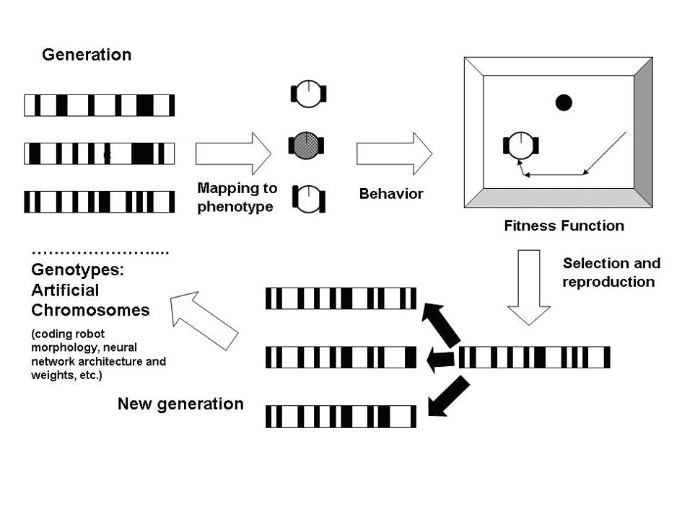
Evolutionary robotics

Slide 17
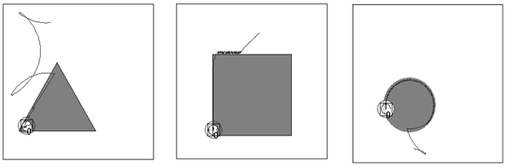
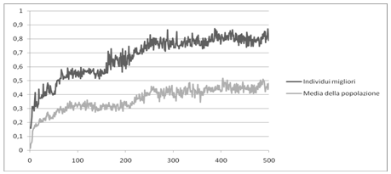
EXPERIMENTAL SETUP N.1
RESULTS
FITNESS CURVE

Slide 18
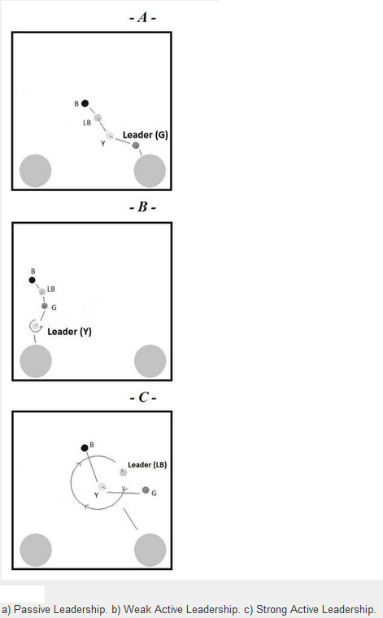
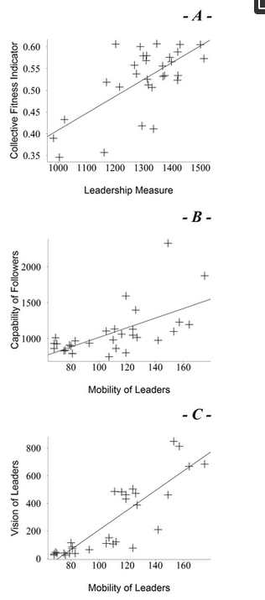
Emergence of Leadership in Robots
Behavioural and quantitative analysis indicate that a form of leadership emerges
Groups with a leader are more effective than groups without.
The most skilled individuals in a group tend to be the leaders.
Further analysis reveals the emergence of different “styles” of leadership (active and passive).
- A - Passive Leadership. - B - Weak Active Leadership.
C - Strong Active Leadership.
(Pugliese, et. Al., 2015)

Slide 19
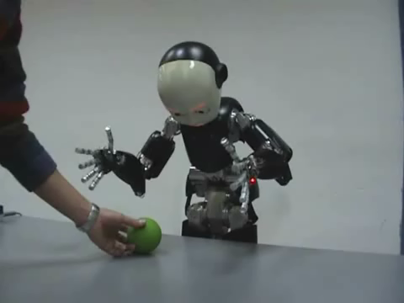
MAY Robotics help to understand social and psychological problems?

Slide 20
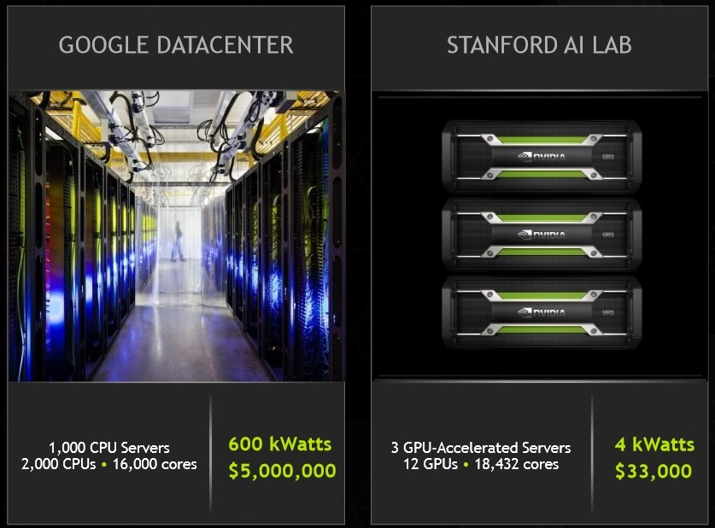
DEEP LEARNING: Neural Networks become more effective
In recent years Deep Neural Networks have achieved noticeably breakthroughs in research (Bengio, 2009). This new methodology dealing with deep neural networks and their training algorithms is called “Deep Learning”. So far, in all the experiments, the resulting performances were many magnitudes better than other machine learning techniques available.
GOOGLE DATACENTER
STANFORD AI LAB

Slide 21
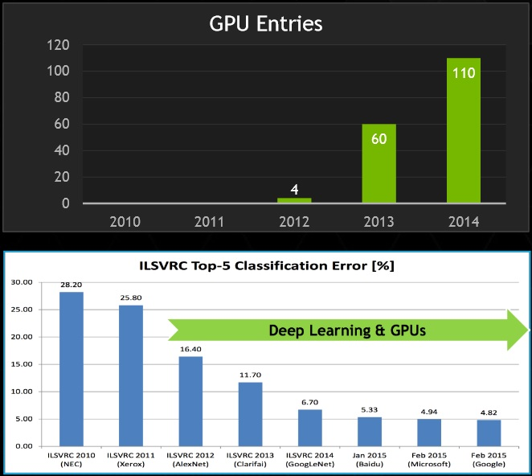
DEEP LEARNING: a cutting-edge approach to Computer Vision and NLP
GPU
The advent of GPUs makes possible the training of very large neural networks with even more than 150 millions of parameters.
BIG
DATA
A new generation of larger training and test sets.
DROPOUT
Better model regularization techniques have been discovered such as “Dropout” or “Data Augmentation”

Slide 22
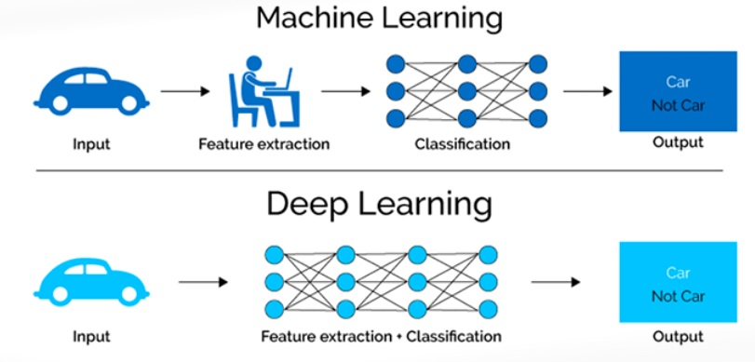
Deep Learning is Machine Learning
Deep Learning refers to algorithms that automatically ‘model’ high-level abstractions in data
here ‘model’ means: define, find, recognize and exploit
here ‘automatically’ means: directly from data, without hinging upon handcrafted, task-specific features.

Slide 23
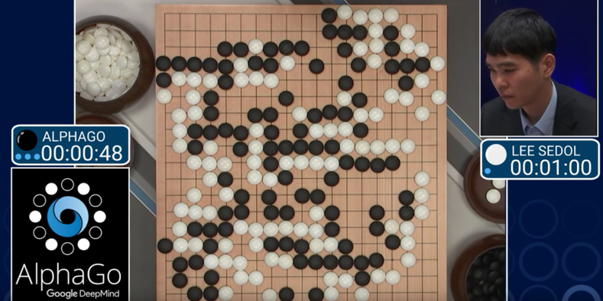
Why Deep Learning over-performed traditional statistics models?
“Deep Learning” approaches can be end-to-end trained without a task-specific feature engineering.
These models are scalable: adding GPUs they can be trained faster.
“Deep Learning is killing every problem in AI” (Elizabeth Gibney, 2016)
23
Basically, statistics is not able to deal with very high dimensionalities of data as Deep Learning does.

Slide 24
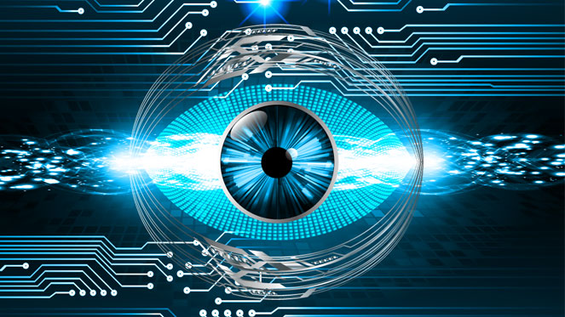
Computer Vision: Where does Traditional Statistics fail?
Computer Vision is an interdisciplinary field that deals with the way algorithms can be made for gaining high-level understanding from digital images or videos.
Statistical methods are not always welcome in computer vision.
Statistical methods seem not scaling up to the challenges of computer vision problems (Chellappa, R., 2012).

Slide 25
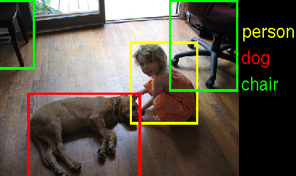
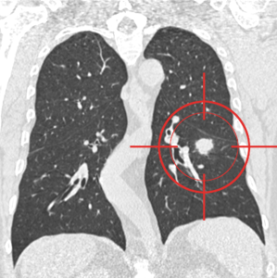
Why does Computer Vision matter so much?
A new study proves the relationship between Vision capabilities and Intelligence (Tsukahara et al., 2016).
Seemingly, human beings have one of the most complex vision systems within the animal realm and this fact would have fostered the evolution of human intelligence.
In other words, Computer Vision needs human-like intellectual capabilities in order to achieve the vision performances required by humans for every-day applications.
BIOMEDICAL IMAGES
EVERYDAY LIFE
25

Slide 26
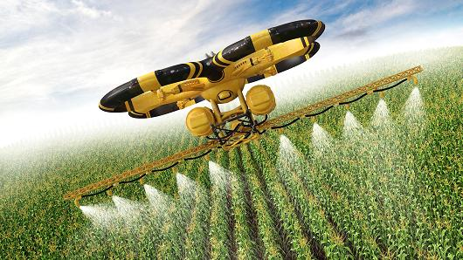
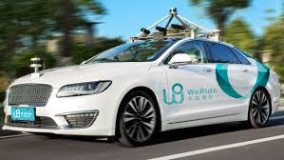
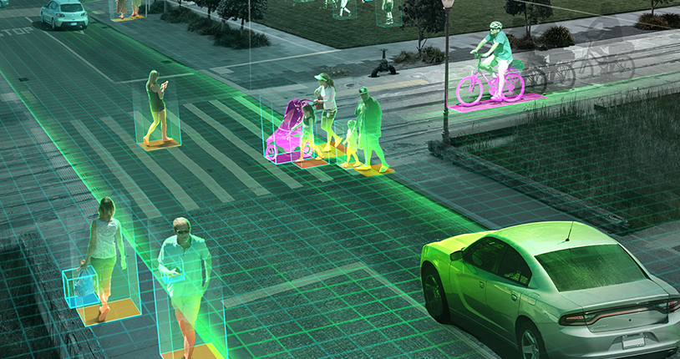
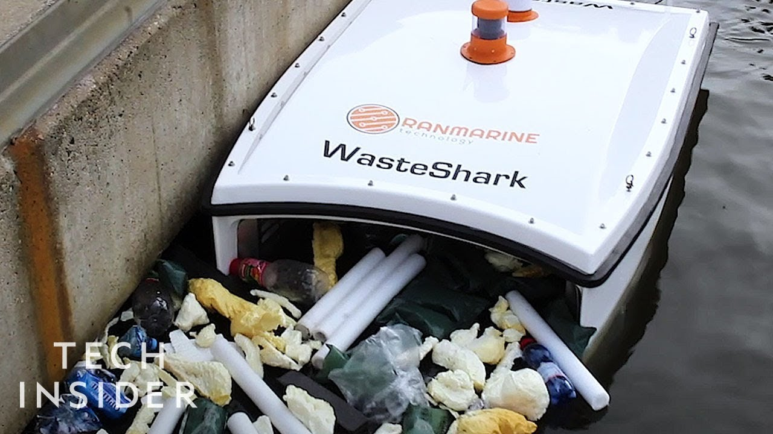
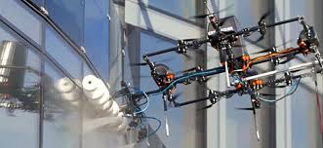
Why does Computer Vision matter so much?
A new generation of machines might accomplish typical human tasks such as recognizing and moving objects, driving cars, cultivating fields, cleaning streets, city garbage collecting, etc.
26

Slide 27
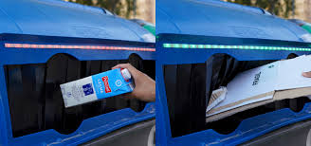
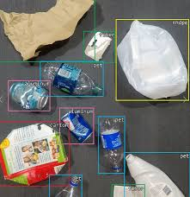
Why does Computer Vision matter so much?
Smart Garbage Bins could classify waste and differentiate it automatically. This might reduce the enormous impact of human errors.
Computer Vision for Recycling
As far as food sustainability is concerned, a first version of a classifier might enable a restaurant or a shop to recognize whether there is still a return of residual food from the production process. Afterwards, by exploiting other sub-classifiers we could catch the opportunity of regenerating this residual food saving resources.
AI applications which can optimize all the flow of interactions with a restaurant, decreasing the process costs and increasing sustainability («Deep Learning al servizio del riciclo», Intervista su Wired, Pugliese, F.). Thanks to Artificial Intelligence, in one work, some researchers have generated menus of some restaurants analyzing all non-structured data from customers online comments.

Slide 28
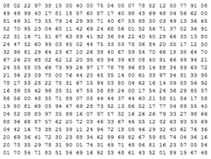

Why does Computer Vision matter so much?
What we see
What computers see
Image Classification Problem

Slide 29

Computer Vision Datasets and Competitions
ImageNet: ImageNet is a dataset of over 15 million labeled high-resolution images belonging to roughly 22,000 categories.
Since 2010 a competition called «ImageNet Large-Scale Visual Recognition Challenge (ILSVRC)» uses a subset of ImageNet with roughly 1000 images in each of 1000 categories.
Train Set: 1.2 million
Validation Set: 50,000
Test set: 150,000

Slide 30

Computer Vision Datasets and Competitions
The CIFAR-10 dataset consists of 60,000 32x32 coloured images divided into 10 classes, with 6000 images per class. There are 50,000 training images and 10,000 test images.
The dataset is divided into five training batches and one test batch, each with 10,000 images. The test batch contains exactly 1000 randomly-selected images from each class. The training batches contain the remaining images in random order, but some training batches may contain more images from one class than another. Between them, the training batches contain exactly 5000 images from each class.
The classes are completely mutually exclusive. There is no overlap between automobiles and trucks. "Automobile" includes sedans, SUVs, things of that sort. "Truck" includes only big trucks. Neither includes pickup trucks.

Slide 31

Computer Vision Datasets and Competitions
The MNIST database of handwritten digits has a training set of 60,000 examples, and a test set of 10,000 examples.
It is a subset of a larger set available from NIST. The digits have been size-normalized and centered in a fixed-size image.
It is a good database for people who want to try learning techniques and pattern recognition methods on real-world data while spending minimal efforts on preprocessing and formatting.
The images contain grey levels as a result of the anti-aliasing technique used by the normalization algorithm. The images were centered in a 28x28 image by computing the center of mass of the pixels, and translating the image so as to position this point at the center of the 28x28 field.

Slide 32

Computer Vision Datasets and Competitions
Fashion MNIST is a dataset of Zalando’s article images consisting of a training set of 60,000 images and a test set of 10,000 examples.
Each example is a 28 x 28 grayscale image associated with a label from 10 classes.
Reasons for replacing MNIST according to Zalando opinions:
- MNIST is too easy. Convolutional nets can achieve 99.7% on MNIST. Classic machine learning algorithms
can also achieve 97% easily.
- MNIST is overused and cannot represent modern CV tasks, as noted by deep learning expert/Keras author François Chollet.

Slide 33

Convolutional Neural Networks (ConvNets or CNNs)
Convolutional Neural Networks (CNN) are biologically-inspired variants of MLPs. We know the visual cortex contains a complex arrangement of cells (Hubel, D. and Wiesel, T., 1968). These cells are sensitive to small sub-regions of the visual field, called a receptive field. Other layers are: RELU layer, Pool Layer. Typical CNNs settings are: a) Number of Kernels (Filters), b) Receptive Field size, b) Padding, c) Stride. These parameters are tied by the following equation:
(W – F + 2P) / S + 1
Each neuron in the convolutional layer is connected only to a local region in the input volume spatially. In this case there are 5 neurons along the depth all looking at the same region.

Slide 34
Former Successful Deep Neural Networks
Traditional issues with Convolutional Layers:
Wide convolutional layers determine overfitting and vanishing gradient problem with the Solver (SGD, Adam, etc).
Low depth architectures produce raw features (need to push the depth forward).
Model Regularization :
Dropout - Co-adaptation and Models Ensemble (Srivastava, N. et al., 2014).
Weight penalty L1/L2
Data Augmentation (crop, flip, rotation, ZCA whitening, etc.)
Conv Nets
AlexNet
(2012)
GoogleNet (2014)
Residual Nets
(2015)
VGG Net
(2° ranked in 2014)

Slide 35

The Innovation of Transformers
Transformers change all the game in Natural Language Processing (NLP), which has become one of the pillars of artificial intelligence in a global digital economy.
Transformer models are disruptive and are leading to a new age in Artificial Intelligence. Language understanding has become the mile-stone of language modeling, chatbots, personal assistants, question answering, text summarizing, speech-to-text, sentiment analysis, machine translation, and more.
By means of Transformers, Artificial Intelligence has evolved to billion-parameter models in order to address the challenge of trillion-word datasets.
They get far from the past, leaving the dominance of RNNs and CNNs behind. BERT and GPT models leave the recurrent network layers back and replace them with self-attention mechanisms.

Slide 36

The increasing amount of Data Dilemma
The increasing amount of data requires training AI models at a very large scale, therefore Transformers launch new era of parameter-driven AI. Learning to understand how hundreds of millions of words fit together in sentences requires a tremendous amount of parameters.
Transformers encoders and decoders contain attention heads that train separately, parallelizing cutting-edge hardware. Attention heads can run on separate GPUs opening the door to billion-parameter models and soon-to-come trillion-parameter models. OpenAI trained a 175 billion parameter GPT-3 Transformer model on a supercomputer with 10,000 GPUs and 285,000 CPU cores.

Slide 37

What are Foundation Models?
Foundation Models are fully trained transformer models that can perform hundreds of tasks even without fine-tuning. Foundation models at this scale offer the tools we need in this massive information era.
In the field of Sentiment Analysis for example, how many humans it would take to read the content of billions of tweets or posts on social networks in a few minutes?
How many humans would be needed to translate the millions of pages published each day on the web?
How many humans it would take to write the transcripts of all of the vast amount of hours of streaming published per day on the web?
How many humans are required to replace AI image captioning for the billions of images that continuously appear online?

Slide 38

AI 2.0 and Industry 4.0
Transformers are industrialized, homogenized deep learning models designed for parallel computing on supercomputers.
Thanks to homogenization, one transformer model addresses a wide range of tasks with no fine-tuning. Transformers can perform self-supervised learning on billions of records of raw unlabeled data with billions of parameters.
These particular architectures are called foundation models. Foundation model transformers represent the edge of the Fourth Industrial Revolution that began in 2015 with machine-to-machine automation that will connect everything to everything.
Artificial intelligence in general and specifically Natural Language Processing (NLP) for Industry 4.0 (I4.0) has gone far beyond the software practices of the past.
An Industry 4.0 Project Manager may go to OpenAI’s cloud platform, sign up, obtain an API key, and get to work in a few minutes. On the other side, a user can enter a text, specify the NLP task, and obtain a response sent by a GPT-3 transformer.
Finally, a user can go to GPT-3 Codex and develop programs without any coding knowledge.

Slide 39





AI 2.0 and Industry 4.0
A GPT-3 model might not fit a specific task. For example, a project manager, consultant, or developer might want to use another system provided by Google AI, Amazon Web Services (AWS), the Allen Institute for AI, or Hugging Face.
Should a Project Manager choose to work locally? Or should the implementation be done directly on Google Cloud, Microsoft Azure, or AWS? Yes
Should a development team select Hugging Face, Google Trax, OpenAI, or AllenNLP? Yes
Should an Artificial Intelligence specialist or a Data Scientist use an API with practically no AI development? Yes

Slide 40

Use Case 1: AI for Lung Cancer Detection
Lung Cancer Dataset
Kaggle: In 2010, Kaggle was founded as a platform for predictive modeling and analytics competitions on which companies and researchers post their data.
Statisticians and data scientists from all over the world compete to produce the best models.
Data Science Bowl 2017 was the biggest competition focused on “Lung Cancer Detection”. The competition was founded by Arnold Foundation and awarded $1 million in prizes (1st ranked $500,000).
Train Set: around 150 CT labelled scans images per patient from 1200 patients encoded in DICOM format.
Stage 1 test set: 190 patients CT scans.
Stage 2 test : 500 patients CT scans.

Slide 41

Use Case 1: AI for Lung Cancer Detection
Lung Cancer Models

Slide 42


Use Case 1: AI for Lung Cancer Detection
Candidate Nodule Selection via UNET
Dilation, Erosion, Nodules Distance Merging
False Positive Reduction via WideResNet
Lung Cancer Results
Cancer /
Non cancer
42

Slide 43

Use Case 2: AI for the automatic classification of Causes of Death
Detection Model
For each individual death occurring within the national territory, the certifying physician records the information on the causes of death in this part of the paper certificate
Istat Form D4-D4bis ‘Death Certificate

Slide 44
Use Case 2: AI for the automatic classification of Causes of Death
The project aims to:
identify the most suitable AI methods for coding causes of death;
create an algorithm for coding causes of death by applying these methods;
evaluate the performance of automatic coding and the quality of the data by applying this algorithm.
The main expected results are:
a reduction in coding variability among coders and in errors, resulting in improved quality;
in view of the imminent replacement of the paper form with an electronic model, AI methods will be useful to maintain high performance in recognizing medical text, even in the absence of the preprocessing currently applied during the registration of paper forms.
an increase in the number of death certificates coded completely automatically, without human intervention;

Slide 45
Use Case 2: AI for the automatic classification of Causes of Death
The information on the causes is recorded by physicians on a paper death certificate, digitized, and coded according to the tenth revision of the International Classification of Diseases (ICD-10) of the World Health Organization (WHO).
The application of the ICD is a complex process that involves:
first, assigning a code to all the causes certified by physicians on the forms (multiple causes).
then, selecting only one code for each death: the underlying cause.
Both phases are carried out according to the rules described in the ICD, and both the multiple causes and the underlying cause are used for mortality statistics.

Slide 46
Use Case 3: AI for the automatic classification of Causes of Death
Training set 22_23: about 4 million texts. 53,876 classes after class cleaning and drops with cutoff. Too much data for training: we sample progressively (starting from 300,000 texts).
DS_Gold_standard (external): 951 texts assigned a code whose correctness has been verified.
TEST_08_09 (test_set_blind): 11,909 texts to be labeled.
Valid ICD codes Flag (A, C, CON, P, etc). Example: Separators (‘;’, ‘/’, etc). Example: CACHESSIA TERMINALE CON IRA IN GRANDE ANZIANO coded as N179 / R54.
(Note: “Cachessia terminale con IRA in grande anziano” = “Terminal cachexia with acute renal failure in a very elderly patient.”)

Slide 47

Use Case 2: AI for the automatic classification of Causes of Death
TF-IDF on the dataset to obtain the normalized term-document matrix; Random Forest is used for classification (which works on SL).
We take a sample of 300,000 texts for training. Initially 54,767 classes, later reduced to 27,364, after non-semantic splitting (in cases where the number of classes equals the number of texts). We use a cutoff of 2, meaning we consider only classes with at least two instances. There are about 17,666 classes that appear only once, and these are removed. In the end, we are left with 9,698 classes.

Slide 48
Use Case 2: AI for the automatic classification of Causes of Death
On training set of 300,000: Accuracy: 0.9761% F1-score (macro-weighted): 0.9745%
On test set (20%): Accuracy: 0.9467% F1-score (macro-weighted): 0.9422%
Accuracy on test set of about 65,161 texts:
#codes = #texts (size = 63,636, 97.66% of the test dataset): Accuracy: 0.9528% – F1-score (macro-weighted): 0.9505%
#codes > #texts (size = 1,525, 2.34% of the test dataset): Accuracy: 0.69% – F1-score (macro-weighted): 0.71% → 1,060 correct, 465 incorrect (outputs exported to Excel and CSV for sharing)
#texts > #codes (size = 0)
(Note: The “%” signs seem to be used instead of decimals — e.g., accuracy 0.9761 likely means 97.61%.)

Slide 49
Use Case 2: AI for the automatic classification of Causes of Death
Accuracy on test set of about 65,161 texts: #codes > #texts (size = 1,525, 2.34% of the test dataset): Accuracy: 0.69% – F1-score (macro-weighted): 0.71% → 1,060 correct, 465 incorrect.
The correct cases are mostly those in which one text corresponds to two codes.
We check what percentage of the texts corresponding to the correct cases are present in the training set: 915 out of 1,050 (86%). We check what percentage of the texts corresponding to the incorrect cases are present in the training set: 76 out of 475 (16%).
Theory: Random Forest performs well when it finds the same words combined in the same way in the training set.

Slide 50
Use Case 2: AI for the automatic classification of Causes of Death
Accuracy on test set (sample of 950 “gold_standard” texts): For this dataset, the initial number of classes is 876. After non-semantic splitting (in cases where the number of classes equals the number of texts — i.e., for 197 cases), we obtain 847 classes, and the number of texts to be classified becomes 1,154. The classes are reduced to 716 after removing the time period.
Accuracy on “gold_standard” test set: overall 0.41% F1-score → problem: only 24% of the gold standard texts are present in the training set, while 62% of the classes are present in the training set.
#codes = #texts (size = 948, 82.15% of the gold standard dataset): Accuracy: 0.55% – F1-score (macro-weighted): 0.52%
#codes > #texts (size = 206, 17.85% of the gold standard dataset): Accuracy: 0.033% – F1-score (macro-weighted): 0.033% → 7 correct, 199 incorrect (outputs exported to Excel and CSV for sharing)
#texts > #codes (size = 0)
OBSERVATION: for the label encoding of the classes, we include both the classes present in the training set and those in the gold standard, to prevent cases where classes in the gold standard are missing from the training data. In the previous case, this issue did not arise because we had obtained it using a stratified train-test split, which ensures that each class has a sample in both the training and test sets.

Slide 51
References
Reimann, M. W., Nolte, M., Scolamiero, M., Turner, K., Perin, R., Chindemi, G., ... & Markram, H. (2017). Cliques of neurons bound into cavities provide a missing link between structure and function. Frontiers in computational neuroscience, 11, 266051.
van Gerven, M., & Bohte, S. (2018). Frontiers Research Topic: Artificial Neural Networks as Models of Neural Information Processing. Frontiers in Computational Neuroscience, Retrieved, 20.
Pugliese, F., Acerbi, A., & Marocco, D. (2015). Emergence of leadership in a group of autonomous robots. PLoS One, 10(9), e0137234.
Nolfi, S., & Floreano, D. (2002). Synthesis of autonomous robots through evolution. Trends in cognitive sciences, 6(1), 31-37.
Bengio, Y. (2009). Learning deep architectures for AI. Foundations and Trends® in Finance, 2(1), 1-127.
Chellappa, R. (2012). Mathematical statistics and computer vision. Image and Vision Computing, 30(8), 467-468.

Slide 52
References
Tsukahara, J. S., Harrison, T. L., & Engle, R. W. (2016). The relationship between baseline pupil size and intelligence. Cognitive Psychology, 91, 109-123.
Francesco Pugliese - Deep Learning al servizio del Riciclo https://www.wired.it/attualita/tech/2018/09/20/party-cloud-ibm-deep-learning/
Adam, S. P., Alexandropoulos, S. A. N., Pardalos, P. M., & Vrahatis, M. N. (2019). No free lunch theorem: A review. Approximation and optimization: Algorithms, complexity and applications, 57-82.
Catanese, E., Bruno, M., Stefanelli, L., & Pugliese, F. (2023, September). Measuring Social Mood on Economy during Covid times: effects of retraining Supervised Deep Neural Networks. In 5th International Conference on Advanced Research Methods and Analytics (CARMA 2023) (pp. 139-147). Editorial Universitat Politècnica de València.
Bernasconi, E., De Fausti, F., Pugliese, F., Scannapieco, M., & Zardetto, D. (2022). Automatic extraction of land cover statistics from satellite imagery by deep learning. Statistical Journal of the IAOS, 38(1), 183-199.

Slide 53
References
Pugliese, F., Pappagallo, A., & De Cubellis, M. (2024, June). Generation of Synthetic Data from Mobile Network Operators (MNO) Data Through Generative Adversarial Networks (GANs). In Scientific Meeting of the Italian Statistical Society (pp. 69-74). Cham: Springer Nature Switzerland.

Slide 54
Thanks
FRANCESCO PUGLIESE | francesco.pugliese@istat.it

